Slide 1
Introduction to Machine Learning
Srivatsa Kundurthy

Slide 2


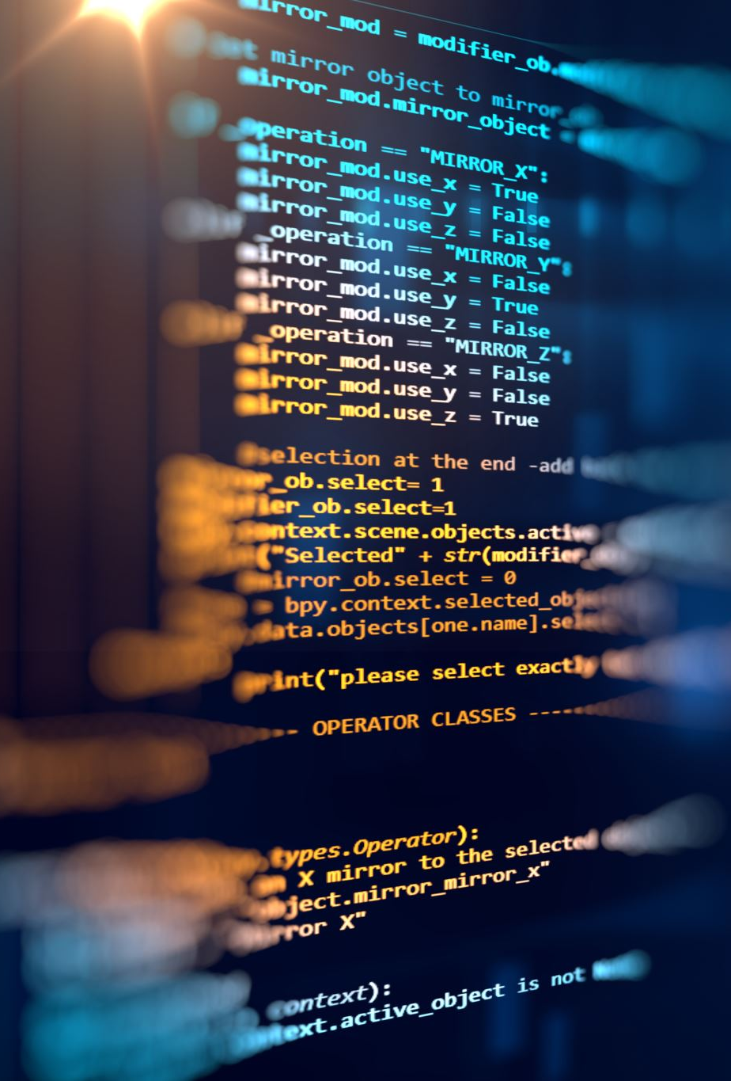
Welcome to Intro to ml!

Slide 3
Outline
What is ML?, Using Data, Deep Learning Intro
01
Neural Networks
02
Training/Optimization
03
Programming Methods, Project Walkthrough
04
Applications, Bridge to Advanced Machine Learning
05
Notes:
Homework: on some days, not always!

Slide 4
This course
By the end of this program, you will be able to:
  Understand what machine learning
  Appreciate data
  Speak about key ML concepts
  Apply your knowledge to further, deeper learning in the subject
Notes:
Understand what machine learning means beyond the mainstream, “buzzword” concept
Gain an appreciation for the power of data
Be able to speak about key ML concepts at a high level
Apply your knowledge to further, deeper learning in the subject
Show off your skills in a budding field!

Slide 5
Requirements & Etiquette
Things to have
  Quiet location with good internet access
  Pencil + Paper for notes
  Discipline + Attention
Zoom Meeting Policy
  Arrive on time
  Keep your video on
  Stay muted unless you have a question or are prompted

Slide 6
Prerequisites
No programming experience necessary
Basic arithmetic is sufficient
Notes:
Machine learning is a traditionally restrictive subject. All the concepts are based on advanced topics in statistics and calculus. My goal in this course is to simplify these topics to essentially a fifth grade level so that everyone can understand the basis for this field. Obviously, for any further exploration you would need to have a strong grasp of these advanced math topics, but in my opinion they shouldn’t be restrictive of your foundations.

Slide 7
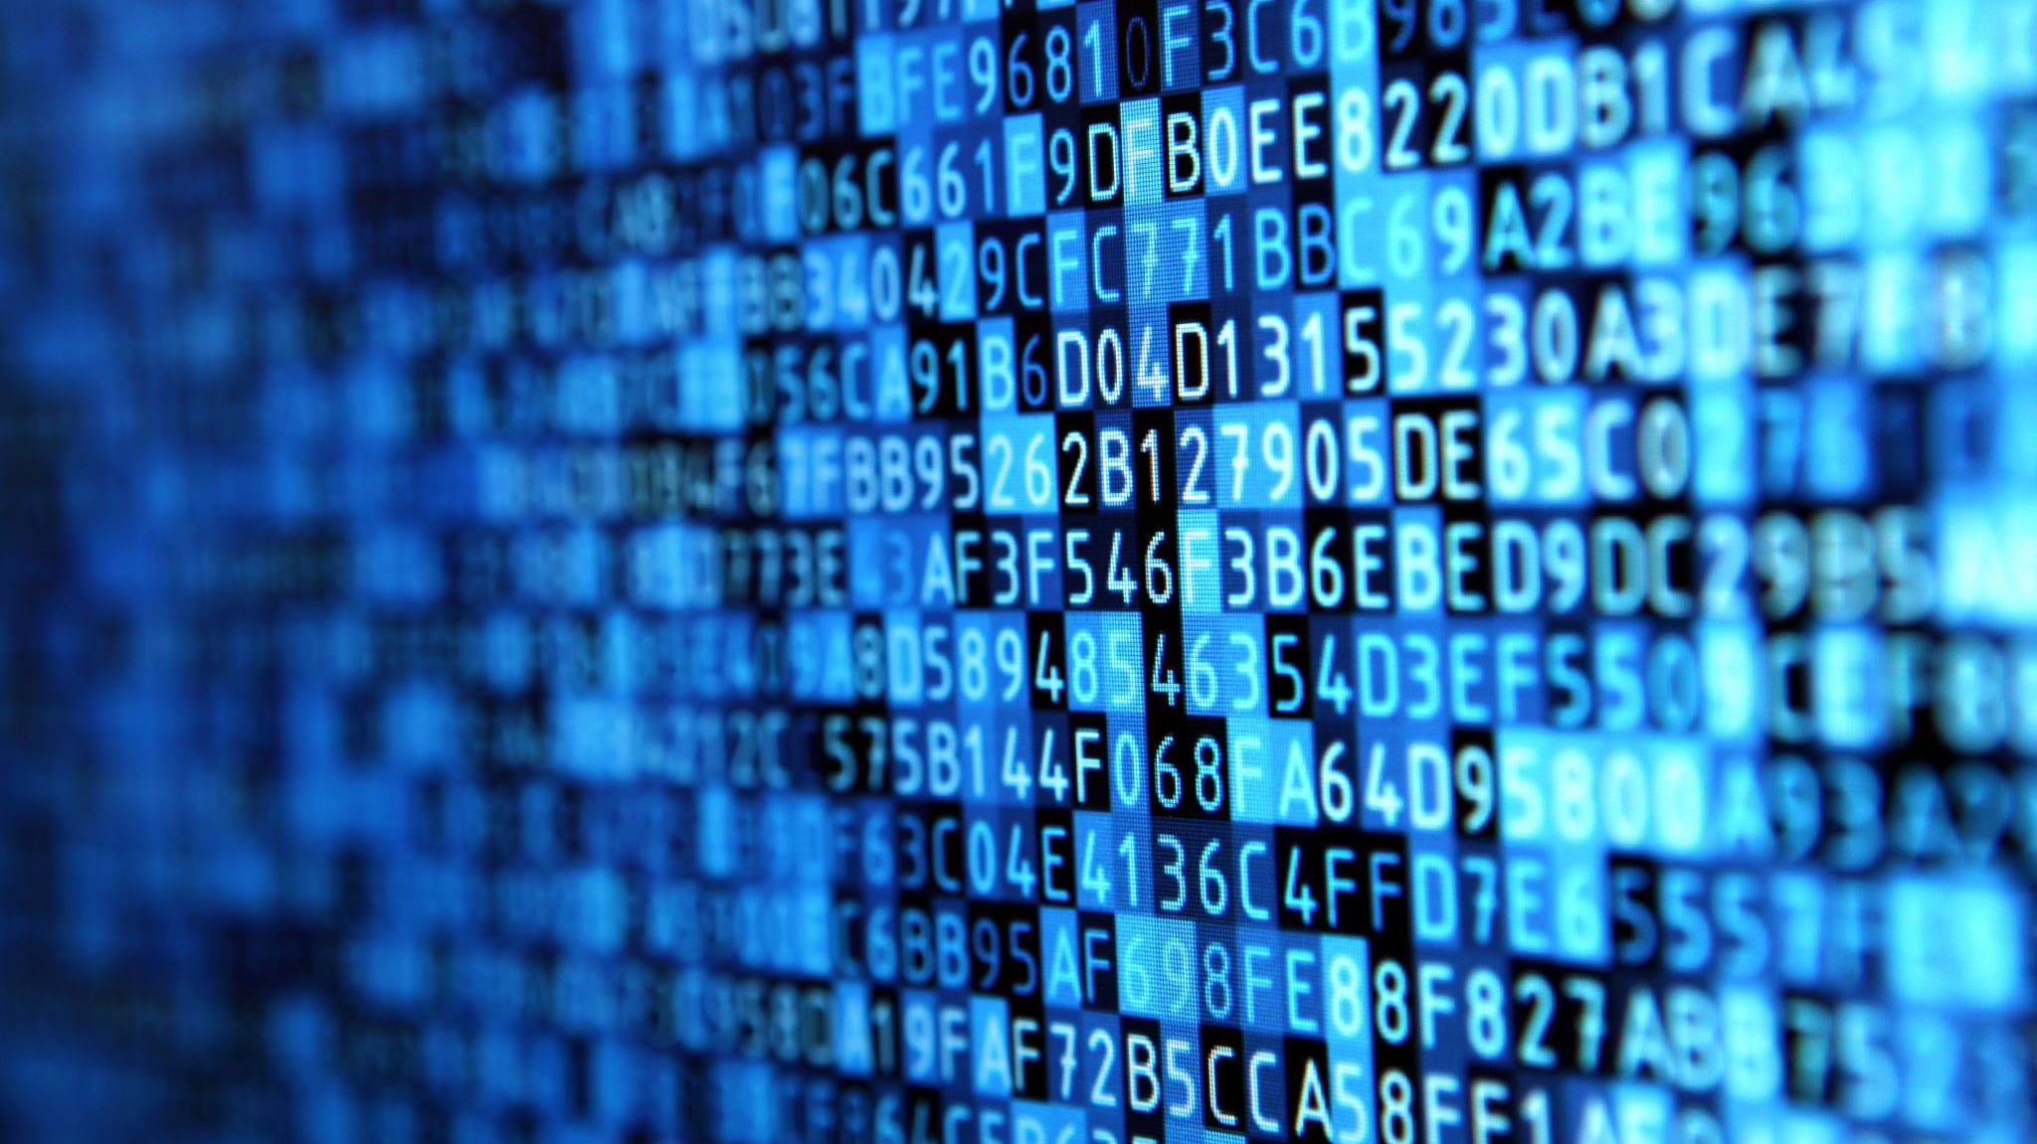
What exactly is Machine learning?

Slide 8
What is learning?
Activity: Teach the instructor how to do addition.
https://padlet.com/skundurthy23/umqnz829d3suice4
Information:
  Briefly describe a simple method to teach an inexperienced individual how to add
Notes:
Do so either via explanatation (alg) or intuitive example

Slide 9
Learning:
“the acquisition of knowledge or skills through experience, study, or by being taught”
In the chat: describe one specific skill you learned and how you learned it!
  “I learned to shoot a basketball by watching professionals and mimicking their form through practice”
Notes:
There are lots of ways to learn.

Slide 10
You answer!: What is machine learning?
Padlet Wall

Slide 11
What do you already know about machine learning?
List anything you know in the Padlet below!
https://padlet.com/skundurthy23/o4afxoub3qiyd5vb

Slide 12
Machine learning
A machine’s use of data and algorithms to automatically adopt an action or skill
  Using data of hand-drawn digits to “learn” to classify digits
This is not a trivial task!
  Learning is hard!
So, how?
Notes:
Data -> information
Algorithms -> Actions and steps
If that’s a little underwhelming I’m sorry, science fiction can really give topics a lot of hype.
In other words, humans set up a framework for a computer to learn on its own.
You know it’s hard from experience: there’s tons of small details to focus on, things where we could go wrong, external factors, and crazy variables that makes learning quite a challenge.
But humans are built to learn. So why can’t computers be the same?

Slide 13
Questions?

Slide 14
HOW DO MACHINES LEARN?

Slide 15
Well, how do humans learn?
Activity: What digit?
You’ll see a hand-drawn digit appear on the screen: type into the chat what you think it is.

Slide 16
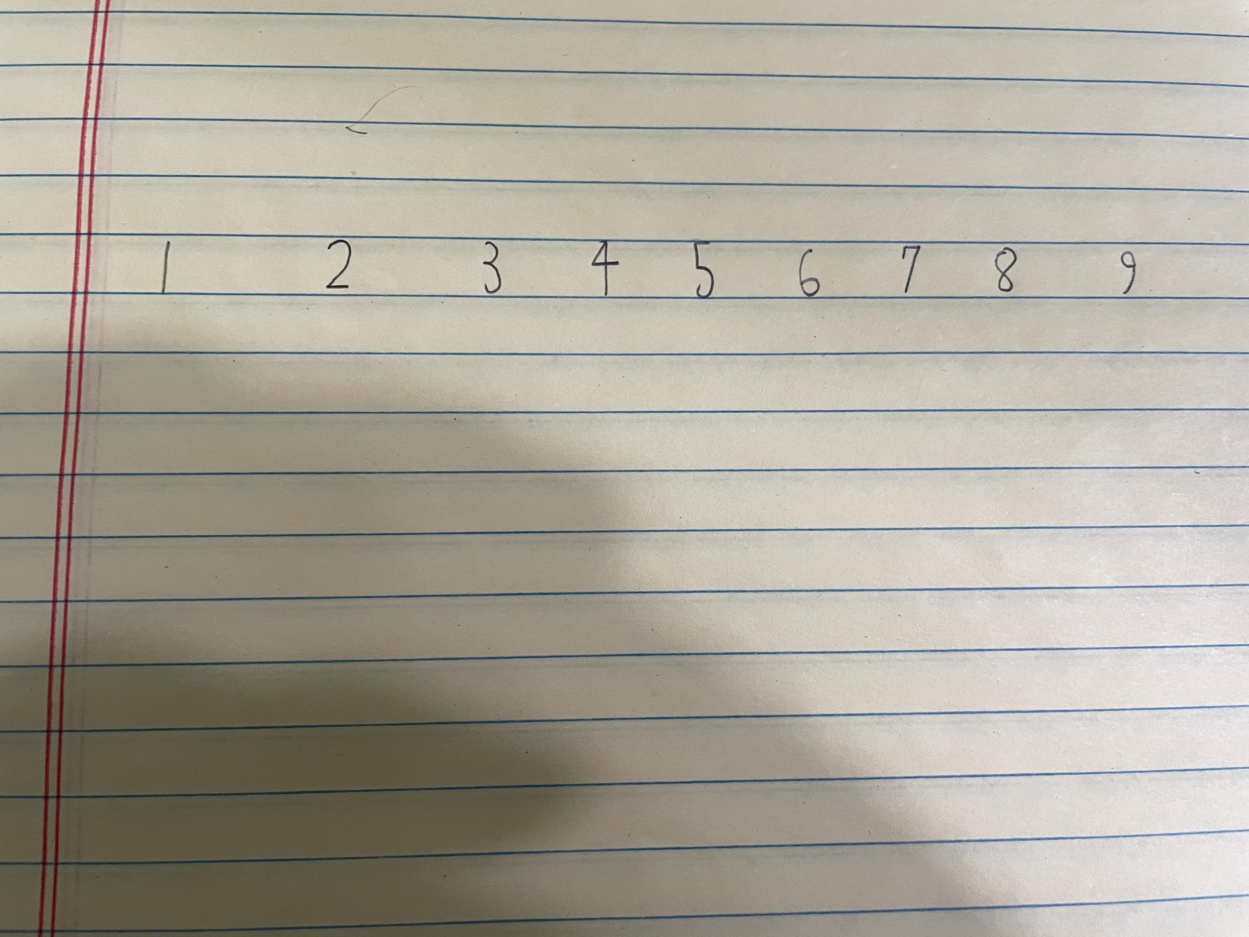

Slide 25
Sloppy digits

Slide 26
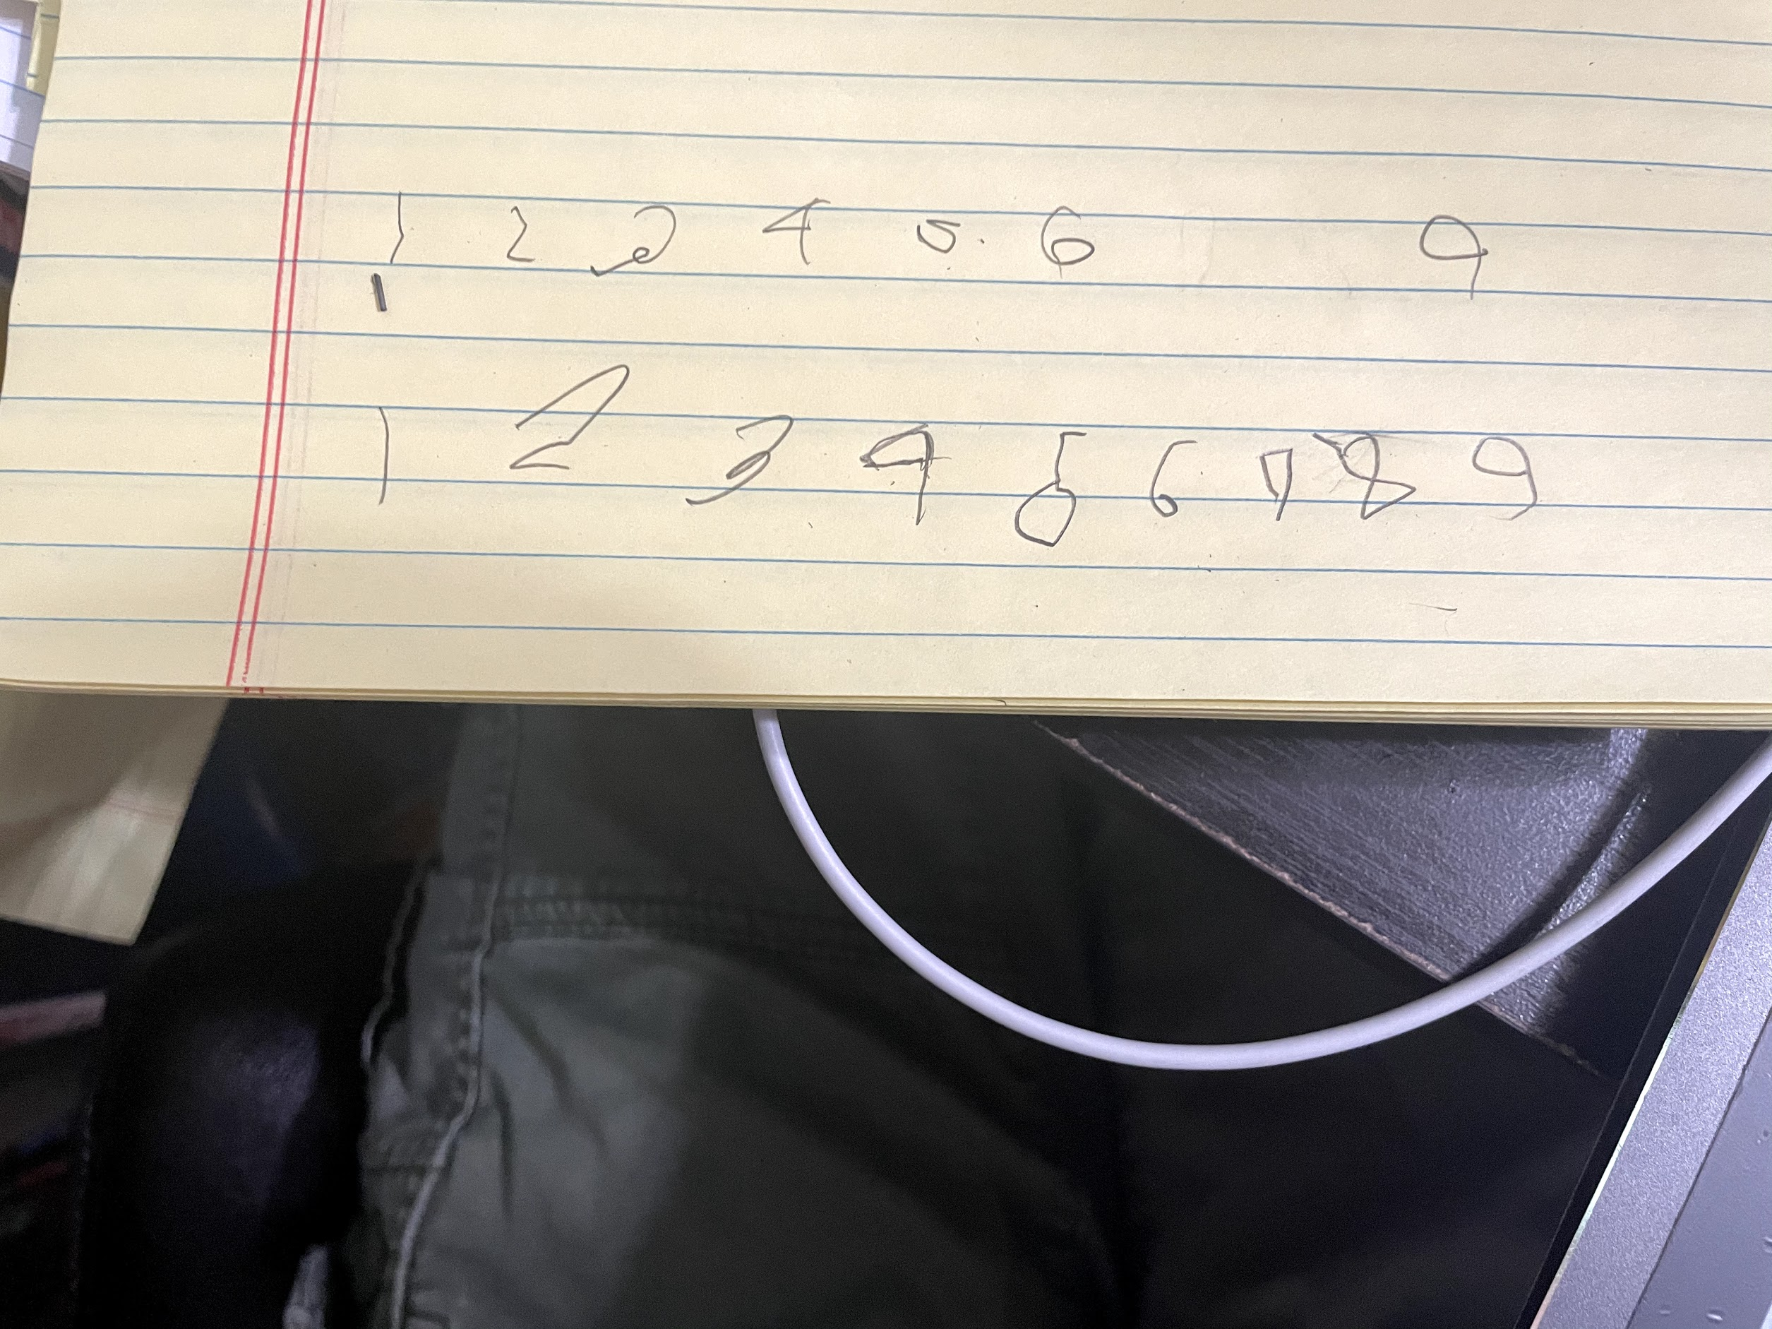

Slide 35
Notes:
Cut through the noise, the lines, the extra pencil marks on the paper, the ridiculously different shapes of the digits to recognize that it’s a four.
You can do it because humans are just that good and intuitive with pattern recognition, but at one point, you also had to learn what a 4 looked like.

Slide 36
Reflection
Classification is an incredible ability
Recognizing patterns is intuitive for people, but not so much for a machine
To train a machine to classify digits we need lots of data
Notes:
It is amazing that we’re able to look at a number and come up with a solid, most likely correct prediction on what it is.
Classification is an incredible ability that we too often take for granted
Classify radically different looking digits accurately
Recognizing patterns is intuitive for people, but not so much for a machine
To train a machine to classify digits we need thousands of different examples : expose it to the minute differences that give it a thorough picture

Slide 37
How does machine learning work?
Fit a model to the data
Model is essentially an equation (though it may not be easily described and represented)

Slide 38
regression
What is the relationship between different variables?
How can we predict a certain value?
Age vs. height
Fit a model to the data

Slide 39
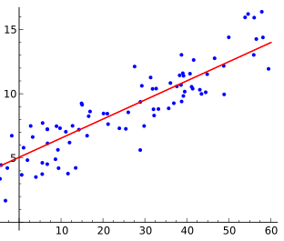
regression
Notes:
If you’ve never seen plots or lines before, just follow along and you’ll be fine.
Data points can be anything, let’s say it’s student scores on a 20 point test compared against minutes spent studying.
We want to design a model to predict what a student will score given the amount of time they spent studying.
Here we have a number of data points that show what is called a linear correlation: the line is the model that satisfies these data points.
Notice that it cannot accurately touch every single data point: instead, the model prioritizes being as close as possible to all the data points.
You see this clearly in this example.
The equation for the line had to be “learned” from the data present
There are lengthy algorithms to accomplish this, and we’ll talk about them soon.

Slide 40
classification
Categorize data into distinct classes
Cat or dog?

Slide 41
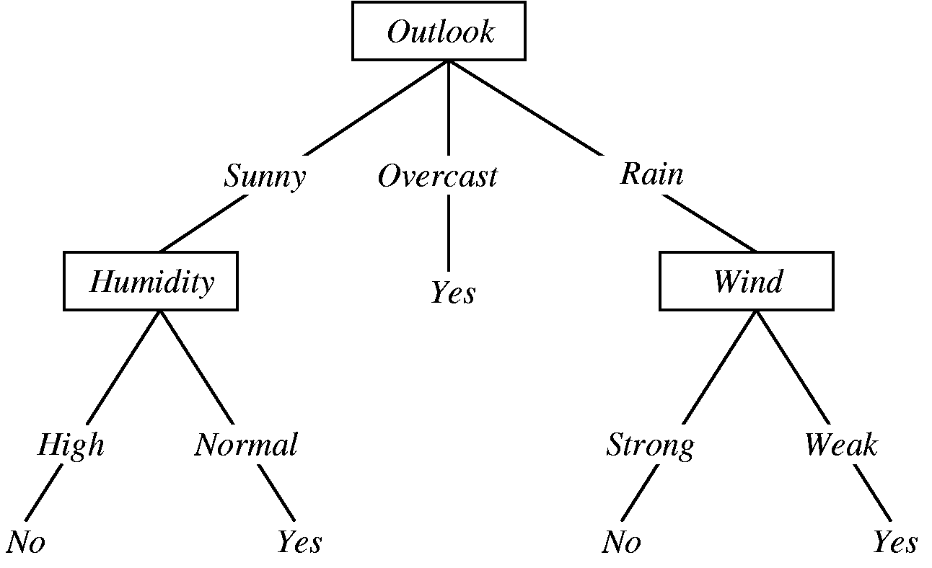
Classification
Notes:
If you’ve ever played the game akinator, you kind of understand what a decision tree is. The genie asks a lot of questions, your answers help the genie “guess” who you’re thinking of to a mind boggling level of detail. It’s very difficult to stump aki if you’re answering honestly.
Learning decision trees is essentially splitting data pieces up based on their specific features -> this is classification. For example, if data is hourly weather information in NYC, we can use trends to bucket hours based on certain characteristics.

Slide 42
Regression or classification?
Trying to model Life expectancy vs. fat consumption
Trying to split up pictures of trucks and cars
Trying to split up devices as laptops, tablets, and phones
Trying to determine what the weather will be tomorrow

Slide 43
Questions?

Slide 44
Deep learning

Slide 45
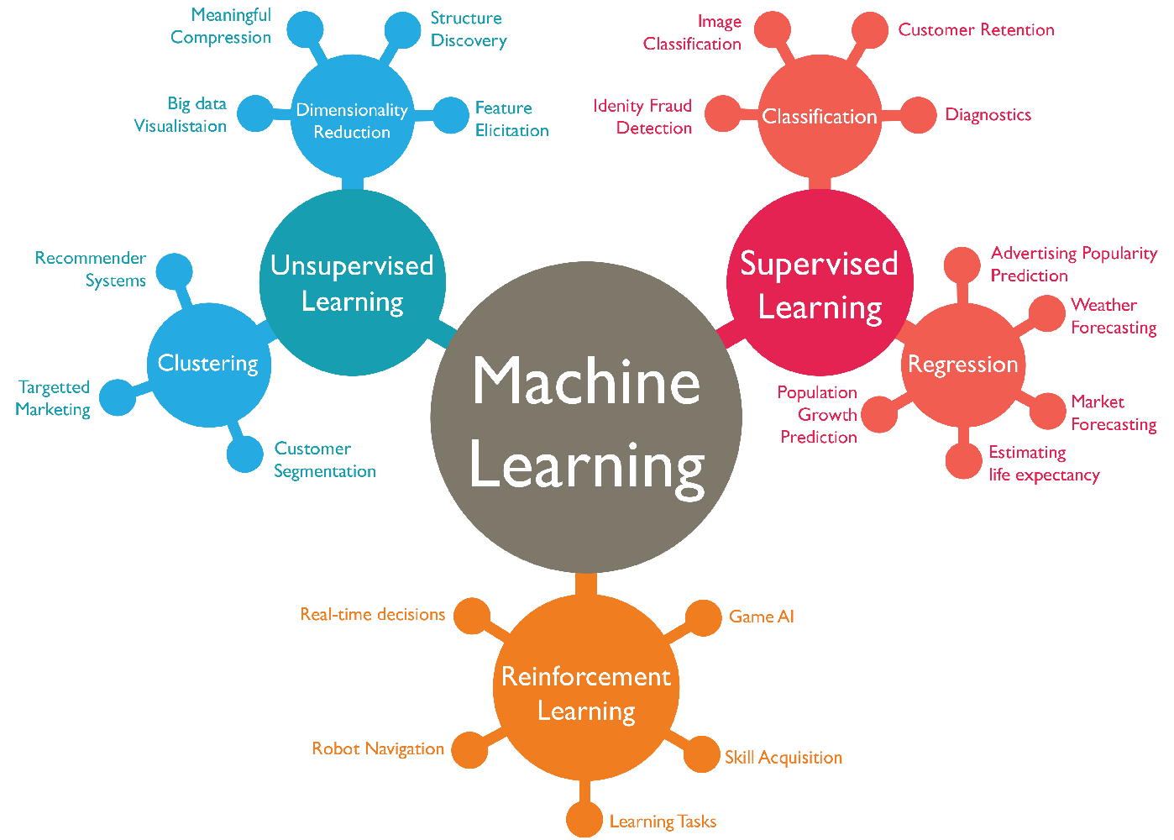
Map of ML
Notes:
We focus on supervised learning

Slide 46
Deep learning: a step further
Deep learning is a subfield of machine learning
Machine learning refers to general tactics used to teach computers
  Regression, decision trees, etc.
Deep learning uses neural networks, which are inspired by the human brain

Slide 47
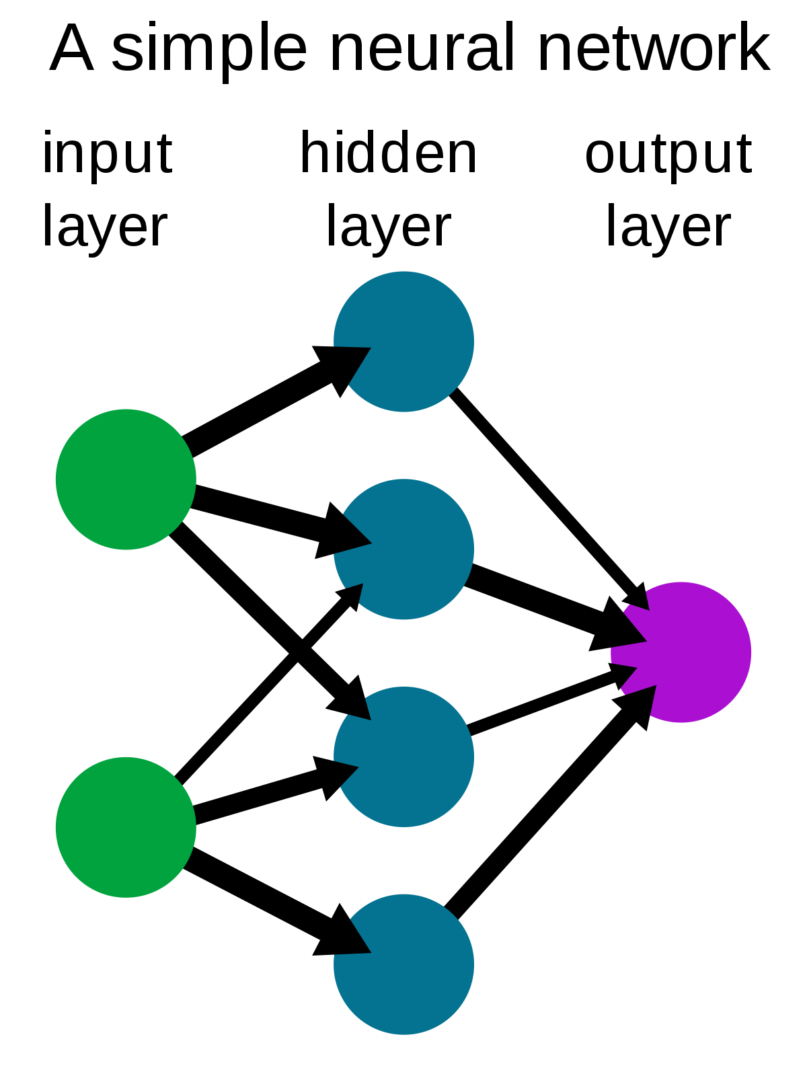

Slide 48
Read my article
https://medium.com/@srivatsa.kundurthy/neural-networks-what-does-it-mean-for-a-machine-to-learn-ecaf4a83be96

